Slide 1
Online event - Exhibition and selling handmade Christmas cards training firms in Drniš and Zadar
Part of the fifth European Vocational Skills Week

Slide 2
Report of implemented activities
Martina Jerković
DRNIŠ
07.-14.
HRVATSKA
November 2020.

Slide 3
This event was a great opportunity to show the acquired knowledge pupils SŠ Ivan Meštrović Drniš in vocational education - economist. This includes online work, the use of new ICT tools, business communication skills and socially responsible business of training companies.

Slide 4
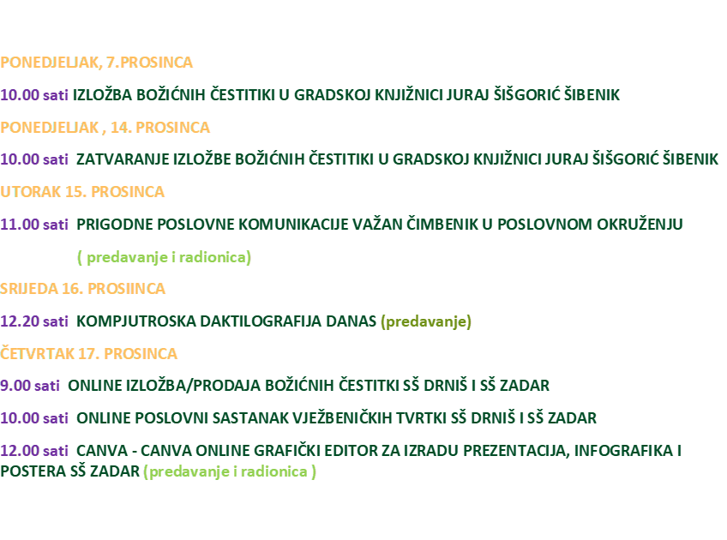
Program of activities - VET
SREDNJA ŠKOLA IVANA MEŠTROVIĆA DRNIŠ
Program

Slide 5
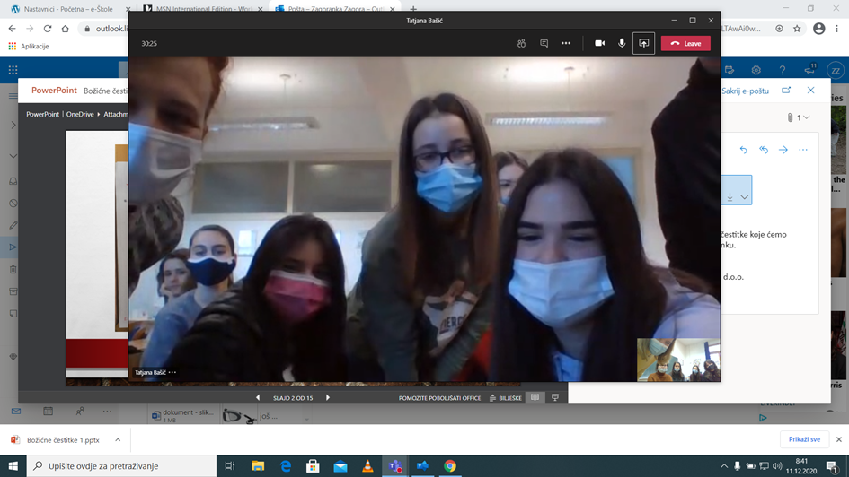
Events
Online meeting pupils Zadar
Online meeting pupils Drniš

Slide 6
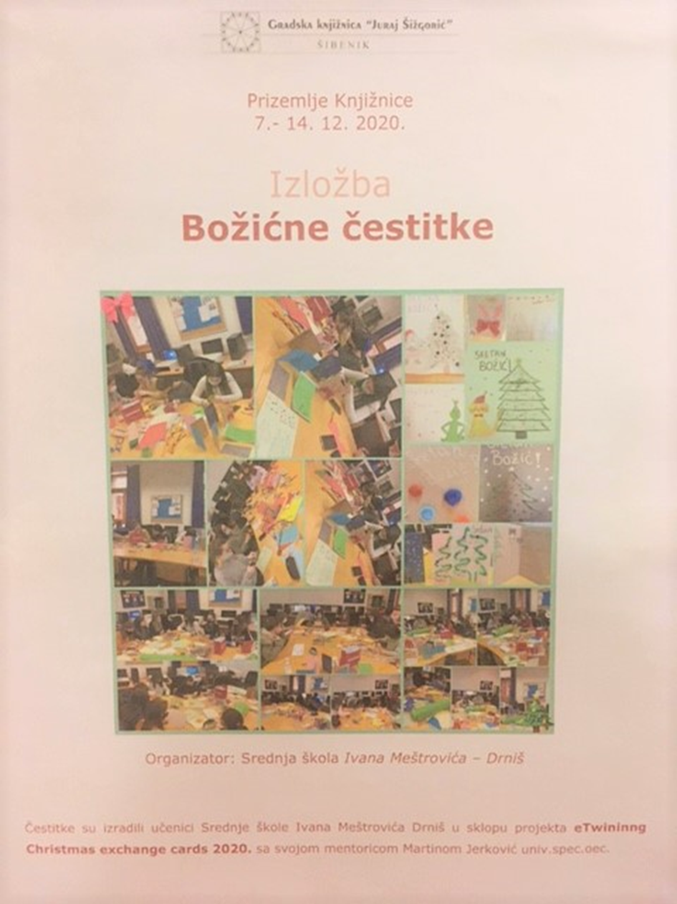
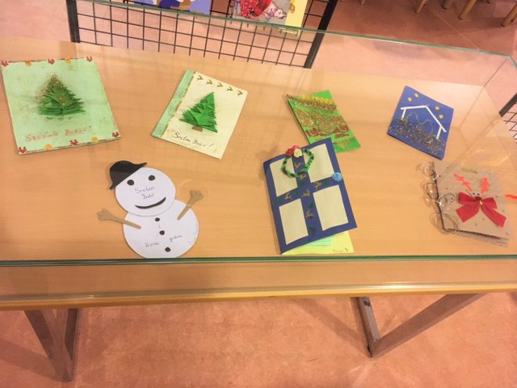
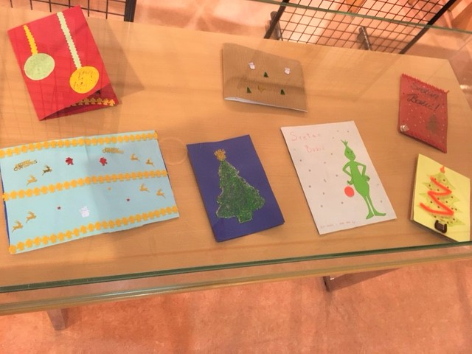
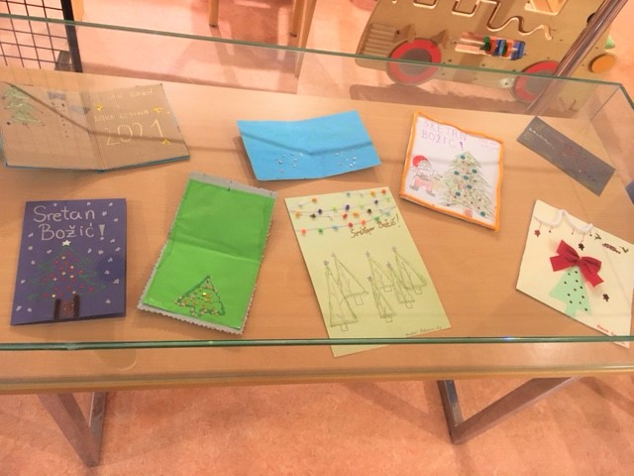
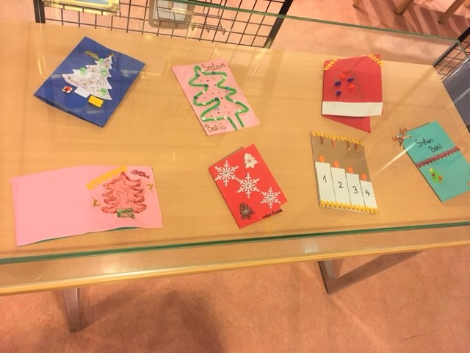
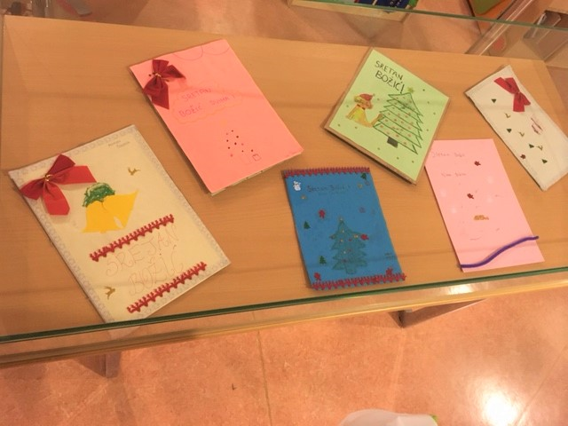
Exibition Christmas cards in public library Juraj Šišgorić
Part of cards in exibition

Slide 7
On 07.12.2020., the Online event - Exhibition and seling handmade Christmas cards training firms in Drniš and Zadar take place in Drniš and Zadar as part of the fifth European Vocational Skills Week.
Because of C-19, students have an online meeting via the Teams platform. Economists from the Zadar School of Economics, Bureaucracy and Trade will have a business meeting with pupils from Ivan Meštrović High School, majoring in economics in Drniš, where they share their knowledge of working in the Canva program and a presentation of their Advent calendar in the Canva program. An online trade show and exhibition of Christmas cards take place after the Canva workshop. All proceeds from the sale of Christmas cards were directed to gifts to students with disabilities.

